Slide 1
Unit 3 Project Scheduling
Agile Estimation Techniques

Slide 2
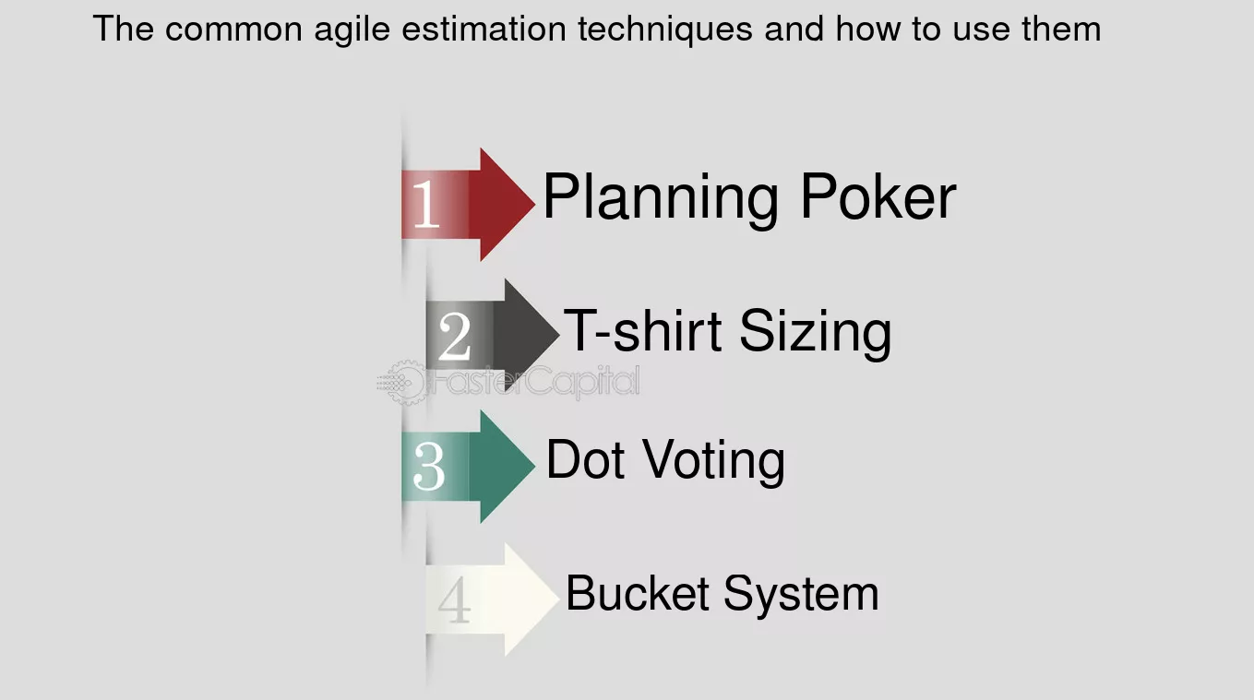

Slide 3
Story Points
A Story Point is a relative unit of measure, decided upon and used by individual Scrum teams, to provide relative estimates of effort for completing requirements.
Story Points are intended to make team estimating easier. Instead of looking at a product backlog item and estimating it in hours, teams consider only how much effort a product backlog item will require, relative to other product backlog items.
2-story point task takes about 8 hours, a 5-story point task takes 20 hours, and so on, you can estimate that 1 story point is roughly equivalent to 4 hours.

Slide 4
Dot Voting
The product owner is perceived as the one who decides the ordering of the backlog,
it is actually not his decision. He must rely on stakeholders who are the ones who
decide the importance of each story.
For the product owner, ranking user stories is actually a contact sport with
stakeholders. It requires that he brings all his senses to the task and applies the best
of his thinking, his feelings, and his communication skills to the challenge of
facilitating decision making. The product owner is a facilitator, not a decider.
Because he understands the process of grooming the backlog, he can guide
stakeholders.

Slide 5
Lets Know it more by user story…
College Management system
- everyone from student to the principal and administration should be able to login
- the system should be able to calculate attendance and display it for the students to view
- It should also have the attendance facility for staff.

Slide 6
Key points !!
Definition: A visual voting technique used to prioritize options or ideas.
Purpose: Facilitate group decision-making in a democratic way.

Slide 7
The method is summarized as follows:
Post the user stories on the wall using yellow stickies or in some manner that enables each
item to receive votes.
Give four to five dots to each stakeholder.
Ask the stakeholders to place their votes. Stakeholders should apply dots (using pens, markers,
or, most commonly, stickers) under or beside written stories to show which ones they prefer.
Order the product backlog from the most number of dots to the least.
When you are done with this first pass, it is almost certain that the stakeholders will not be
completely happy with the outcome of the vote. If that is the case, you should review the
voting and optimize it. Here’s what you can do:
Arrange the votes into three groups to represent high, medium, and low priorities.
Discuss stories in each group.
Move items around to create a high-priority list.
Make a new vote with items in the high-priority list.

Slide 8
Advantages & Disadvantages
Advantages of Dot Voting
Inclusivity: Everyone’s opinion matters.
Simplicity: Easy to understand and use.
Quick Results: Fast decision-making process.
Visual Feedback: Clear representation of preferences.
Effective Prioritization: Helps focus on top choices.
Disadvantages of Dot Voting
Groupthink Risk: May lead to conformity.
Limited Voting Power: Equal dots may not reflect expertise.
Potential for Manipulation: Risk of strategic voting.

Slide 9
T-Shirt sizing
T-shirt Sizing is one of the Story points sizing technique to estimate user story usually used in agile projects.
Estimating time for T-shirt sizes can vary significantly depending on the team's experience, the complexity of the tasks, and the context of the project.
Notes:
Tshirt size is an agile project estimation technique used used in agile methodology to determine the time period for a sprint to be completed.

Slide 10
Size Categories
XS (Extra Small): Very simple tasks that require minimal effort.-1 day
S (Small): Small tasks that are straightforward but require some effort.-3days
M (Medium): Moderate tasks that involve a reasonable amount of work and complexity.-1 week
L (Large): Significant tasks that require considerable effort and possibly multiple days of work.-2weeks
XL (Extra Large): Very complex tasks that may require extensive effort, potentially spanning multiple iterations. - 4weeks

Slide 11
User Story
As a food cart employee I want to see all the real time orders with payment_id and change the status .
Scrum Team
Hridaya Patil (Scrum Master) Koustubh Thakare (Product Owner)
Raja Ruswin (Sr.Dev) Paridthi Rathore (Jr. Dev)
Kaustubh Shinde (Fresher)
Notes:
Explaining the user story and giving the estimation

Slide 12
Advantages & Disadvantages
Easy to understand and implement, especially for teams new to Agile.
Without the need to assign exact points or hours, the estimation process becomes quicker, allowing the team to move forward rapidly during planning.
Translating sizes to exact time estimates or story points can be difficult, particularly when teams have varying interpretations of what each size means.
For complex projects, T-shirt sizing might oversimplify tasks, leading to underestimations or poor handling of intricate dependencies between tasks.

Slide 13
Planning Poker
Poker planning is a consensus based collaborative technique often used in Agile project estimation, particularly in Scrum, to estimate the effort required to complete tasks.It helps teams arrive at accurate discussion through collaborative and gamified process ,reducing biases.Planning poker is called so because it combines the concept of estimation with game like approach ,resembling actual poker.

Slide 14
Poker planning uses Fibonacci sequence pattern which help teams make relative estimation rather than absolute ones. Each number represents a level of effort or complexity, allowing teams to compare tasks against each other easily.
Why Fibonacci ?
The point of Fibonacci is to force your hand when estimating larger, complex tasks instead of wasting time nitpicking over minor differences.

Slide 15
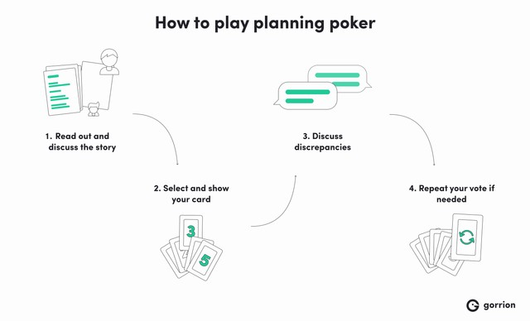


Slide 16
User story
As user ,i want to book a cab so that i can travel to my desired destination quickly and conveniently.
Disha(scrum master) Manasvi(owner)
Anoop(senior developer) Om(junior developer)
Gauri(fresher)

Slide 17
Advantages
Promotes collaboration and discussion
Reduces influence and Bias
Equal participation
Quick consensus
Disadvantages
Time consuming
Difficulty in estimating complex tasks
Experience dependent
Potential for groupthink post reveal

Slide 18
BUCKET SIZE
A Better Solution

Slide 19
Agile Team
Riddhi Patil (Product Owner)
Kshitija Saitavdekar (Jr. dev)
Aditya Reddy (Scrum Master)
Atharva Angre (Sr. Dev)
Abhijit Khambekar (Tester)

Slide 20
Scenario Description
I want to add product to my shopping cart so that I can purchase items during checkout.

Slide 21
Bucket Size
Bucket sizing is an agile estimation technique that helps teams quickly categorize user stories based on their complexity and effort. We place stories into "buckets" representing different levels of effort—like small, medium, and large. It’s a fast way to get a sense of how much work lies ahead!

Slide 22
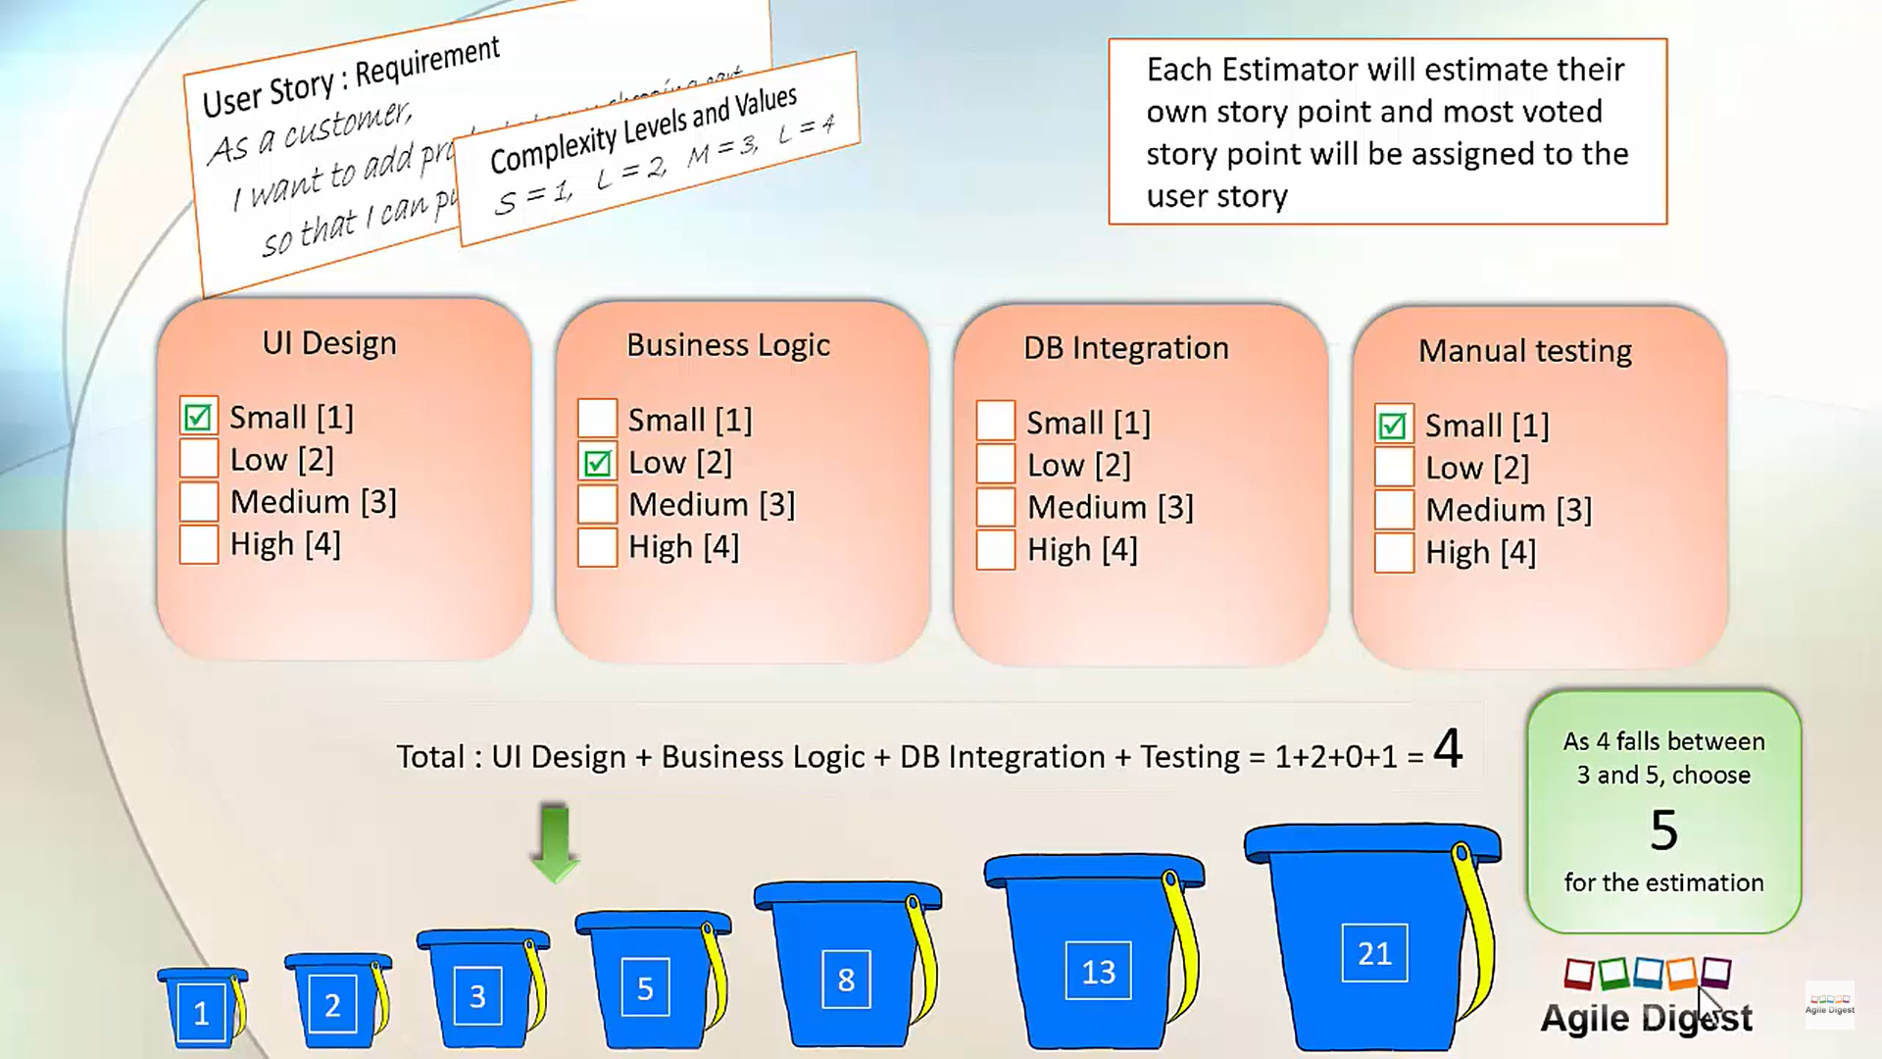

Slide 23
Advantages of Bucket Size
Improved Prioritization: Bucket size helps teams prioritize tasks based on effort and complexity, ensuring that higher-value work is completed first.
Enhanced Planning: It aids in sprint planning by providing a clearer understanding of the workload, allowing for more accurate forecasting.
Better Resource Allocation: Teams can allocate resources more effectively by understanding which tasks require more effort, helping to balance the workload.
Increased Transparency: Having a defined bucket size fosters communication within the team and with stakeholders about project progress and challenges.
Facilitates Adaptability: By categorizing tasks, teams can more easily adapt to changes in priorities or scope, allowing for flexibility in the development process.

Slide 24
Disadvantages of Bucket Size
Subjectivity in Estimation: Determining bucket size can be subjective, leading to inconsistencies in estimates across different team members.
Oversimplification: Bucket sizes might oversimplify complex tasks, potentially overlooking nuances that could impact project outcomes.
Potential for Misalignment: If not communicated effectively, different interpretations of bucket sizes can lead to misalignment between team members and stakeholders.
Risk of Rigid Structures: Relying too heavily on bucket sizes can lead to rigid planning, which may counteract Agile’s emphasis on flexibility and responsiveness.
Focus on Size Over Value: There’s a risk that teams might prioritize tasks based solely on bucket size rather than the actual value or impact of the work being done.

Slide 26
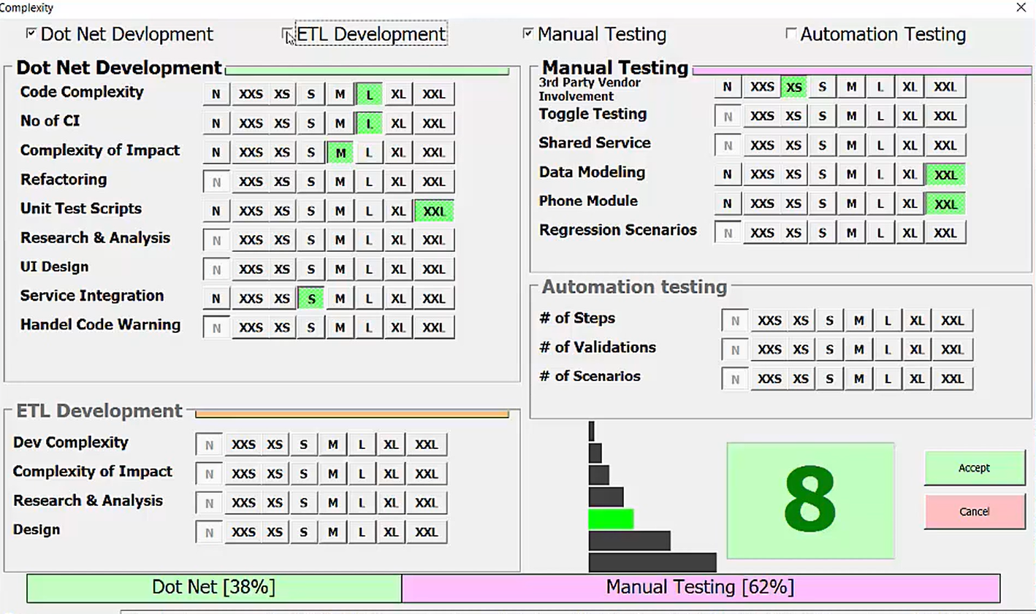

Slide 27
Conclusion
Helps Prioritize Tasks: Bucket size makes it easier for teams to decide which tasks to tackle first based on how much work they involve.
Improves Planning: It gives teams a better idea of how much work is ahead, helping them plan their time more effectively.
Efficient Resource Use: Knowing the size of tasks helps teams distribute work evenly, so no one is overloaded.
Boosts Communication: Clear bucket sizes make it easier for team members and stakeholders to understand progress and any issues.
Requires Balance: While bucket size is helpful, teams should also focus on the importance of tasks and stay flexible.
Be Aware of Limitations: Teams need to recognize that bucket sizes can be subjective and sometimes oversimplify tasks, which can lead to misunderstandings.

